Slide 1


A PROJECT ON
AUTOMATED TELLER MACHINE
Global Institute of Management, Amritsar.
Supervised by:
Mr. Amit Puri
Submitted by:
ABHI CHOHAN
U-ROLLNO: 1706045
Master of Computer Applications
Punjab Technical University.
June-July, 2018

Slide 2
Company Profile
The Institute where I have pursued my six weeks Industrial Training is NIIT (National Institute of Information Technology), Mall road, Amritsar.
ABOUT NIIT
NIIT is a leading Global Talent Development Corporation, building skilled manpower pool for global industry requirements. The company which was set up in 1981, to help the nascent IT industry and overcome its human resource challenges, has today grown to be amongst world’s leading talent development companies offering learning solutions to Individuals, Enterprises and Institutions.
NIIT’s training solutions in IT, Business Process Outsourcing, Banking, Finance & Insurance, Executive Management Education, and Communication & Professional Life Skills, touch 5 million learners every year. NIIT’s expertise in learning content development, training delivery and education process management make us the most preferred training partner, worldwide.

Slide 3
ABOUT NIIT
Research-based Innovation, a key driver at NIIT, has enabled us to develop programs and curricula that use cutting-edge instructional design methodologies and training delivery. NIIT’s Individual Learning Solutions include industry-endorsed IT training programs like GNIIT, Integrated programs for Engineers (NIIT Engineers); Infrastructure Management programs (NIIT Global Net+).
For working professionals, NIIT Imperia, Centre for Advanced Learning, brings Executive Management Education Programs from premier B-schools in India.
NIIT Institute of Finance Banking & Insurance (IFBI), formed by NIIT with equity participation from ICICI Bank, offers programs for individuals and for people in corporate sector in Banking Services, Financial Services and Insurance Services.
NIIT Unique, Centre for Process Excellence, addresses the increasing demand for skilled workers in the business and technology services industry by providing training.

Slide 4
SUCCESS ACHIEVED BY NIIT:
NIIT has been accorded the Business Super brand 2008 status for the second time by the Super brands Council, US. The first one being for the period 2003-2005.
Ranked as ‘Top Training Company 2008’, by Dataquest magazine, India’s leading ICT publication group Cyber media.
NIIT, USA has been awarded the Gold for ‘Excellence in E-learning Award’ by Chief Learning Officer magazine as part of its Learning in Practice Awards, one of the industry’s highest honors.
NIIT ranked among the ‘Top 20 Companies in the IT Training Industry’ in 2008 by TainingOutsourcing.com.
NIIT was recognized by UNESCO for innovation in ICT in Education in 2008.
NIIT (HiWEL) has been conferred the coveted ‘Digital Opportunity Award’ by World Information Technology Services Alliance (WITSA) in 2008.

Slide 5
SUCCESS ACHIEVED BY NIIT:
Ranked amongst ‘India’s Most Trusted Services Brand’ in a survey by India's one of the leading financial daily- The Economic Times Brand Equity Survey, in 2008.
NIIT is the only Indian Education company from India to be featured in "The BCG 50 Local Dynamos “in 2008.
Ranked amongst India’s ‘Most Respected Companies’ in the IT sector in a survey done by Business World magazine in 2007.
NIIT was ranked as ‘India’s Most Customer Responsive Educational Institution’ as per Avaya GlobalConnect Customer Responsiveness Awards in 2007 for the third consecutive year.
NIIT was voted as the ‘Most Popular Education Brand’ by College and University students in China.

Slide 6
Introduction to Project
I am very glad to introduce my project “AUTOMATED TELLER MACHINE”. Now a day each company or organization prefers the computerized paper-work. Definitely the computer system is more reliable than the manual works. The common human errors can be eliminated with the help of system.
An Automated Teller Machine (ATM) is a computerized telecommunications device that provides the customers of a financial institution with access to financial transaction in a public space without the need for a human clerk or bank teller. On most modern ATMs, the customer is identified by inserting a plastic ATM card with a magnetic stripe or a plastic smartcard with a chip that contains a unique card number and some security information.
ATMs are known by various other names including automated banking machine, money machine, bank machine, cash machine and Any Time Money in India.

Slide 7
Existing system
Existing system creates complexity in doing calculation of collection of money because it is manual.
Existing system creates problems in maintaining records of book keeping.
Existing system, there is large documentary work so it requires space for its storage.
To do the documentary work there is need of extra staff worker.
Existing system takes much more time to updating process of records.
Due to existing system crowding of customer in bank premises are more & pressure of work on bank servants are also more.

Slide 8
Proposed system
The proposed system need to maintain all the records in computerized form.
It is useful to store record systematically & accurately by using this system.
It is useful to reducing the extra work which maintains the records of book keeping & paper less work.
We can easily handle data efficiently & effectively.
The storage space, extra workers, missing files all these possibilities are decreased through this system.
With the help of this system ATM card holder can see all the records about his account only at any time efficiently.

Slide 9
Objectives of the Project
Automated Teller Machine (ATM) system is banking software developed to give facility of bank customer for 24hours & nearer to your location; therefore customer can do their transaction at any time at any place. This software is also help for bank, to minimize crowding of customer in bank premises & pressure of work on bank servants.
Now a day each company or organization prefers the computerized paper-work. Definitely the computer system is more reliable than the manual works. The common human errors can be eliminated with the help of system.
The main objective of ATM system is to help the organization in automating the whole manual processing of the existing system. This project should support multi user environment. The system is fully automated. ATM system is designed to solve the purpose of clarifying system requirement. This system should be able to handle extremely large volumes of data. This system should capable to keep track of all detailed description of the account holder of banks.
The following details are involved in this ATM system project:
ATM Card holder /account /bank customer detail.
Daily transaction detail of each ATM card holder.

Slide 10
Scope of the Project
As this is software it can be used by a wide variety of banks to automate the process of manually maintaining the records related to the each transaction of bank account holder. The main goal of this application is to provide very reliable & efficient service to bank account holder at any time & any location.
This system will cover the following modules:-
Cash Deposit
Cash Withdrawal.
Fast Cash Withdrawal
Mini Statement.
PIN Change.
Balance Enquiry.

Slide 11
Hardware & Software Requirements
Hardware Requirements:
Processor: Pentium 4 or onwards.
Hard Disc: 80GB.
RAM: 512 MB.
Monitor: 15” Color Monitor.
Mouse.
Keyboard.
Software Requirements:
Operating System: - Windows XP (or onwards) or Linux or MacOS.
Java Run Time Environment (JRE) – jdk1.8.0_144 (As Front End Tool).
Apache Derby inbuilt RDBMS in Netbeans (As Back End Tool).

Slide 12
Modules of the System
Cash Deposit: It mainly used for deposit cash amount to their bank account as per customer demand. It is easy process of deposit amount to their bank accounts without filling deposit sleep.
Cash Withdrawal : It mainly used for withdrawal of cash as per customer demand.
Fast Cash Withdrawal: It enables you to designate an amount that you consistently withdraw from your primary checking account. This saves your time if you frequently withdraw the same amount.
Mini Statement: It refers to enquiry of last ten transaction of an authorized ATM card holder. It includes deposit & withdrawal amount of transaction & also contains respective transaction date and current available balance.
PIN Change: It refers to the Change of PIN no of an authorized ATM card holder. It requires giving system old PIN no of the ATM card & then giving new PIN no & confirm the new PIN no.
Balance Enquiry: It refers to enquiry of bank balance of an authorized ATM card holder account to check for the resulting balance after certain transactions.

Slide 13
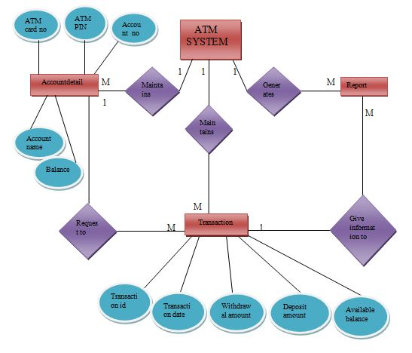
ER Diagram

Slide 14
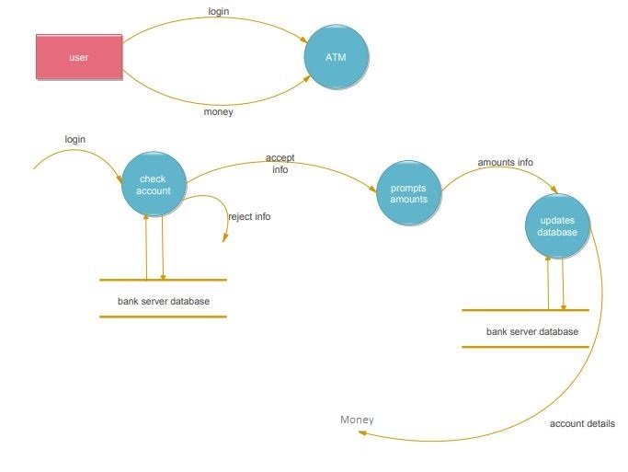
Data Flow Diagram

Slide 15
ACTUAL SCREENSHOTS

Slide 16
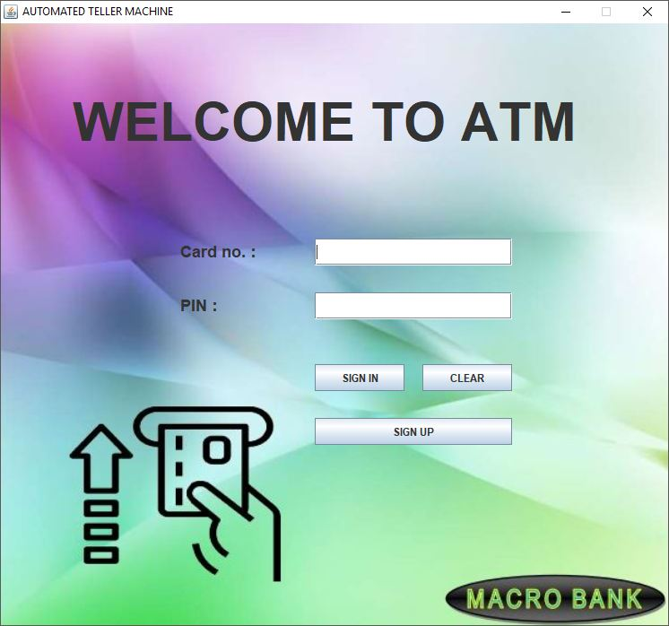
Welcome Screen

Slide 17
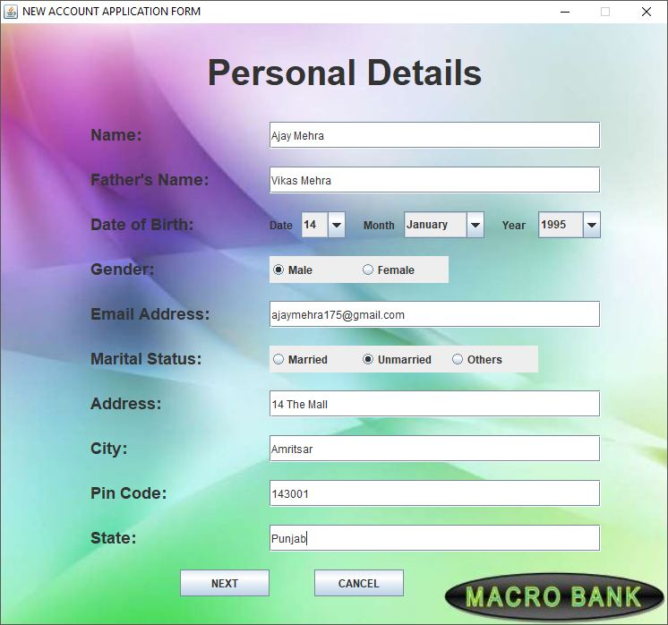
Registration page 1

Slide 18
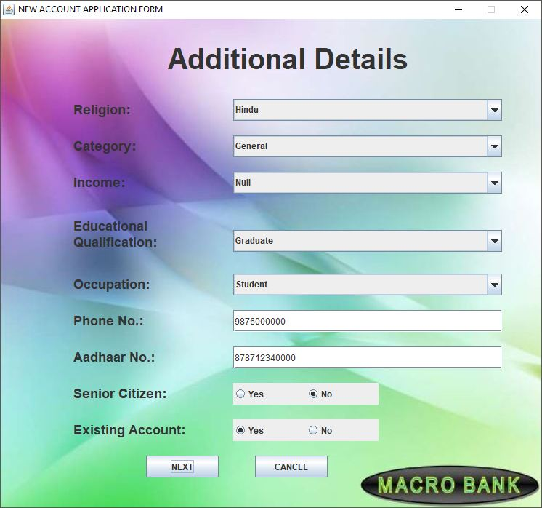
Registration page 2

Slide 19
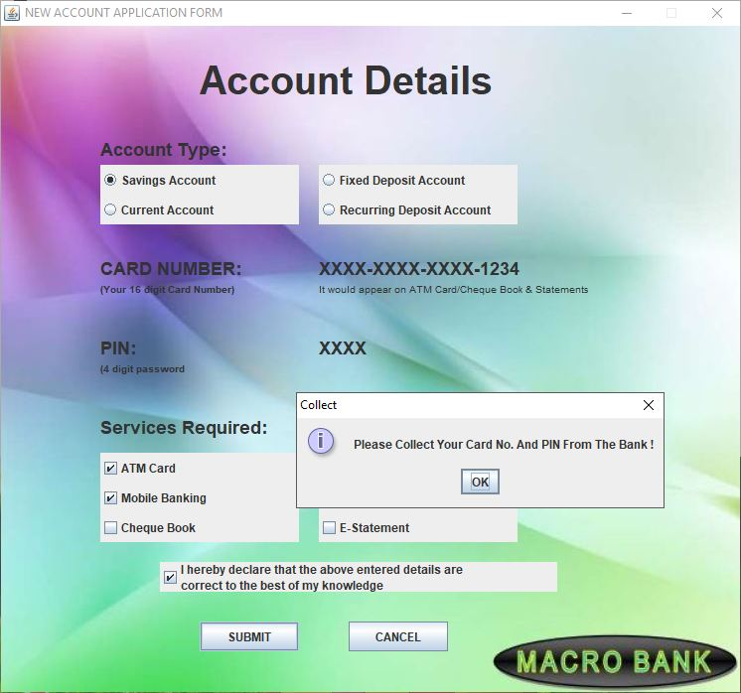
Registration page 3

Slide 20
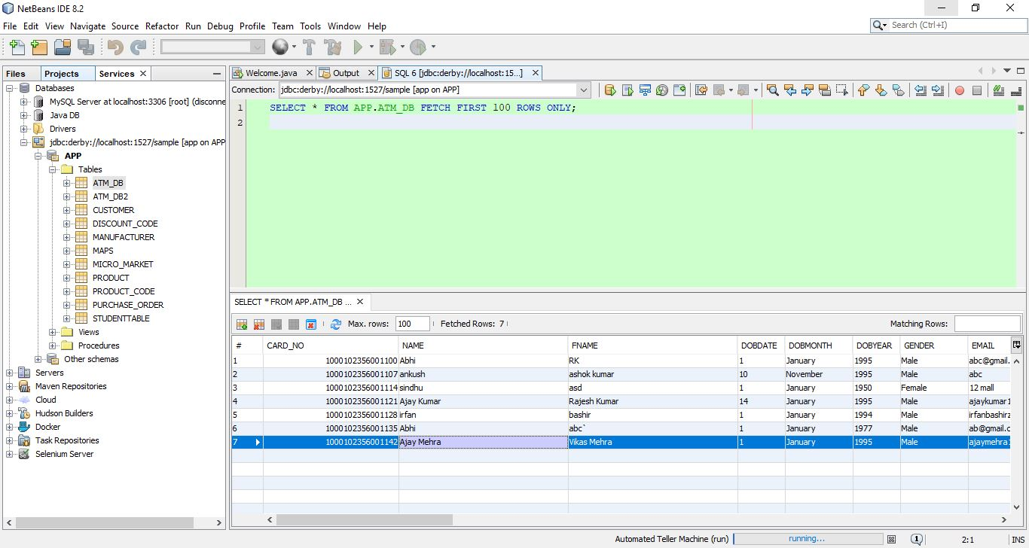
Bank’s DB View

Slide 21
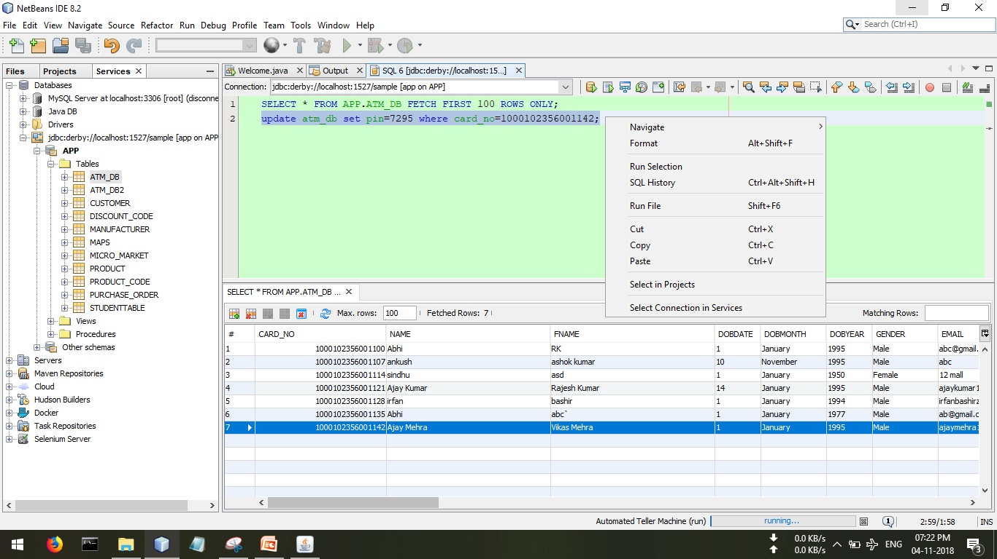
Bank’s DB Updating

Slide 22
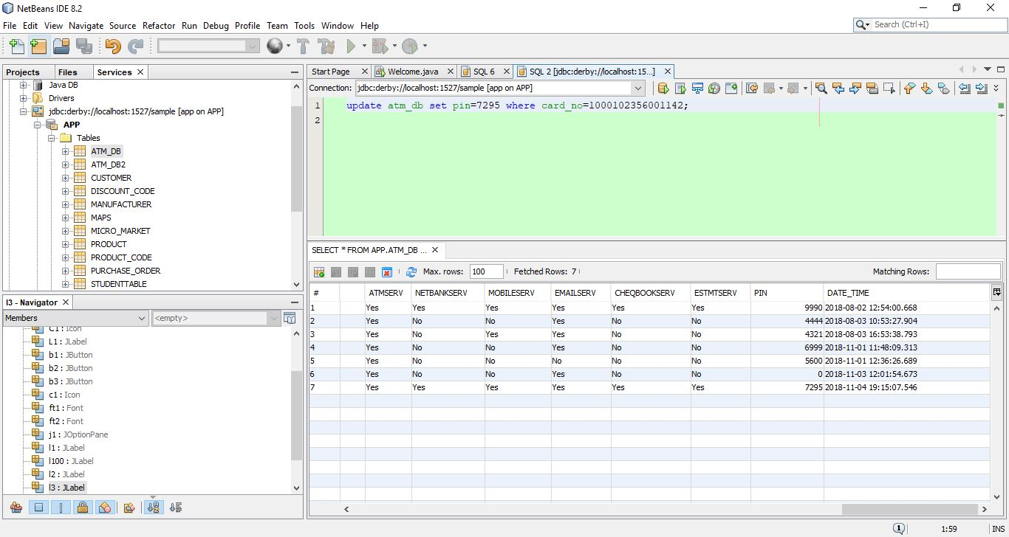
Bank’s DB Updated

Slide 23
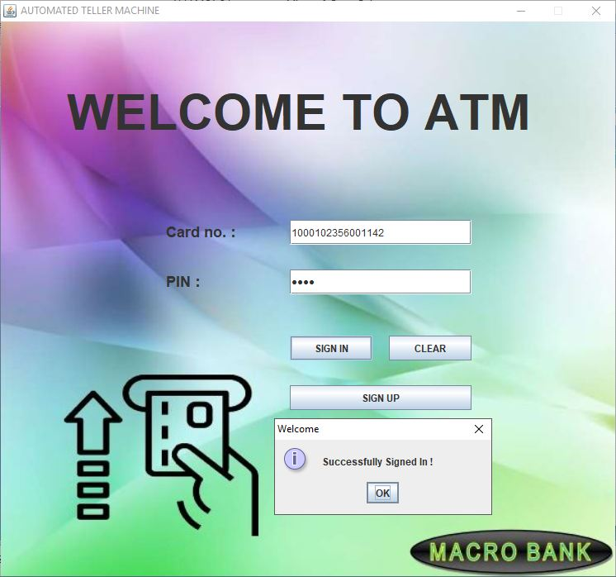
Welcome Screen (Registered User)

Slide 24
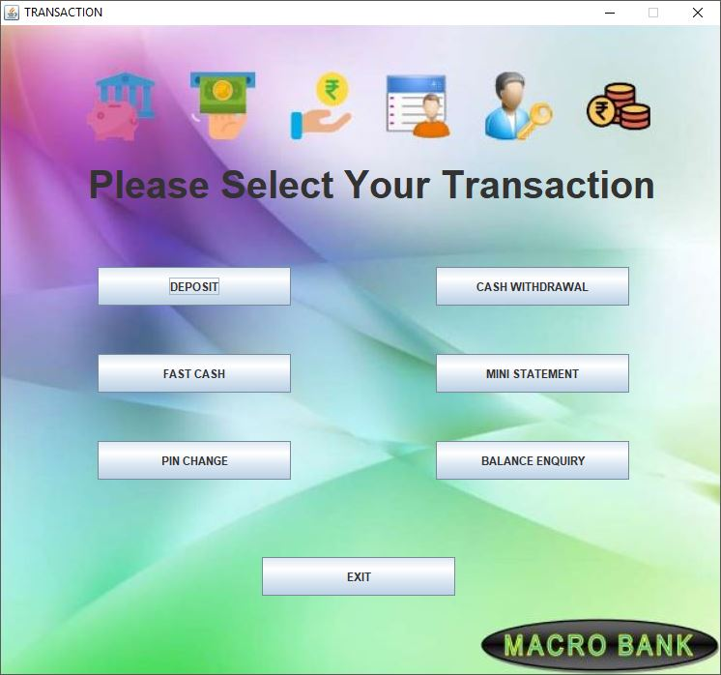
ATM Menu

Slide 25
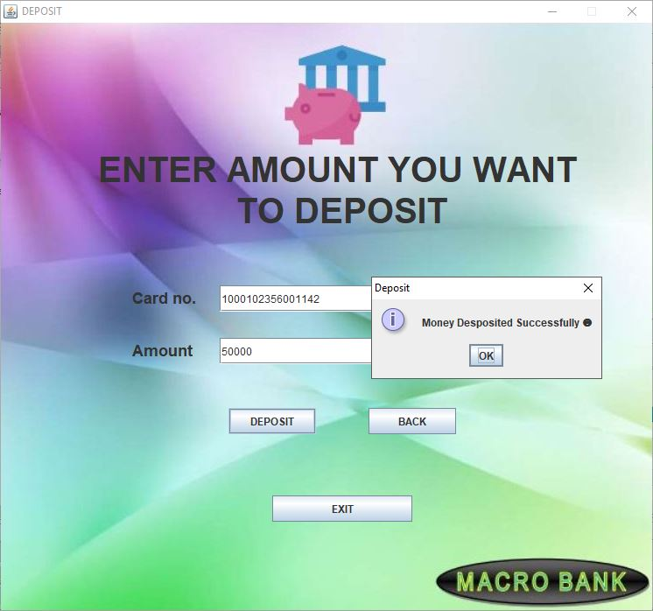
Deposit Money

Slide 26
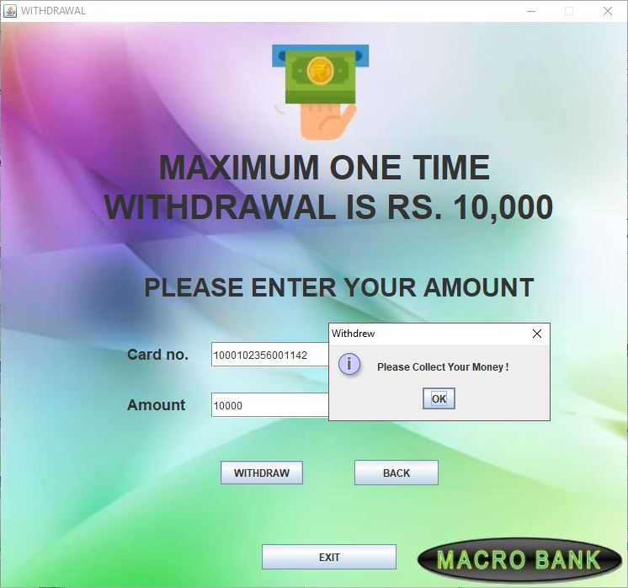
Withdraw Money

Slide 27
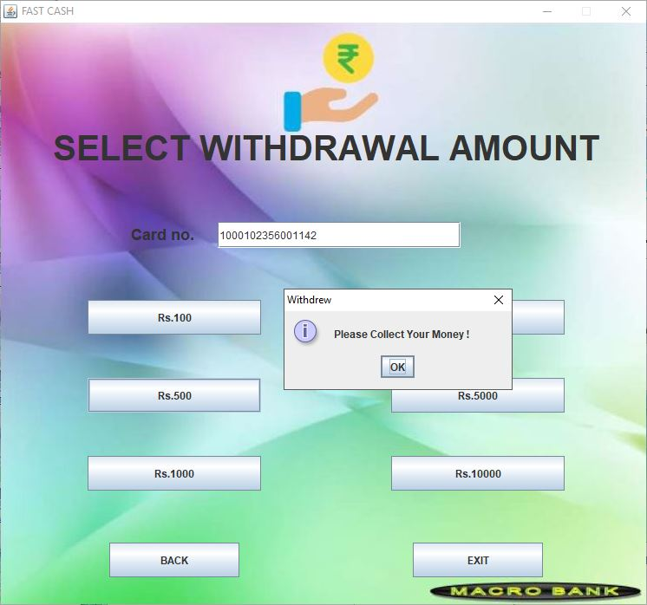
Fast Cash Withdrawal

Slide 28
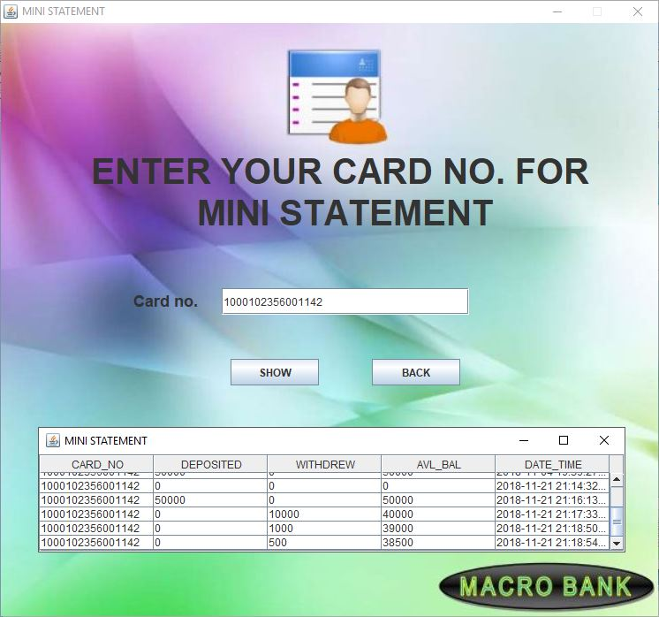
Mini Statement

Slide 29
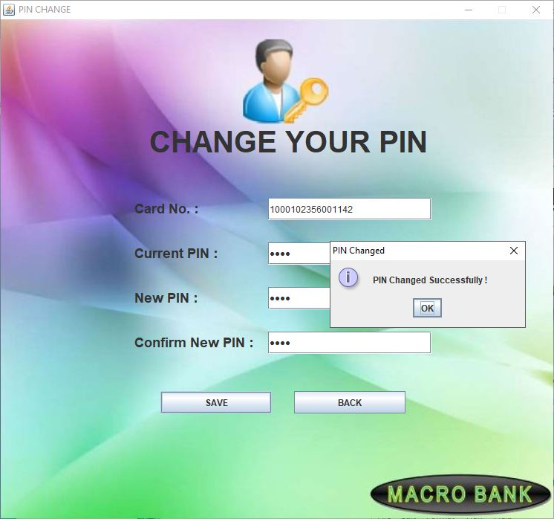
PIN Change

Slide 30
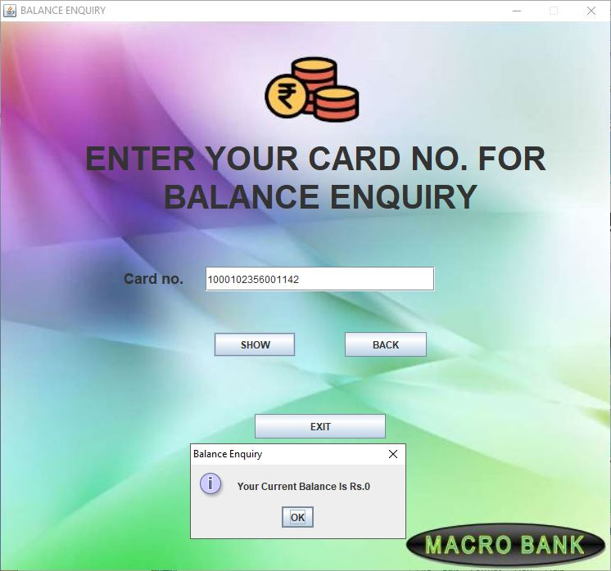
Balance Enquiry

Slide 31
Thank You

